Slide 1

Megaminx
MMR 2020 – Group 3

Slide 2
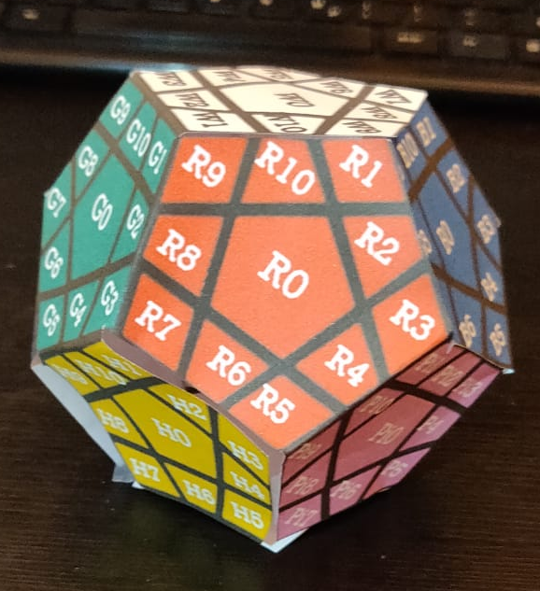
Beginning Position
u
Allowed Moves:
Up
Right
Front
Left
l
r
f
dl
dr

Slide 3
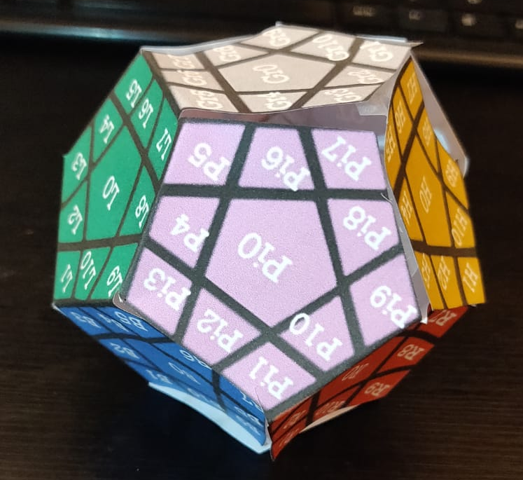
Axis Rotations
r_v
r_upside_down

Slide 4
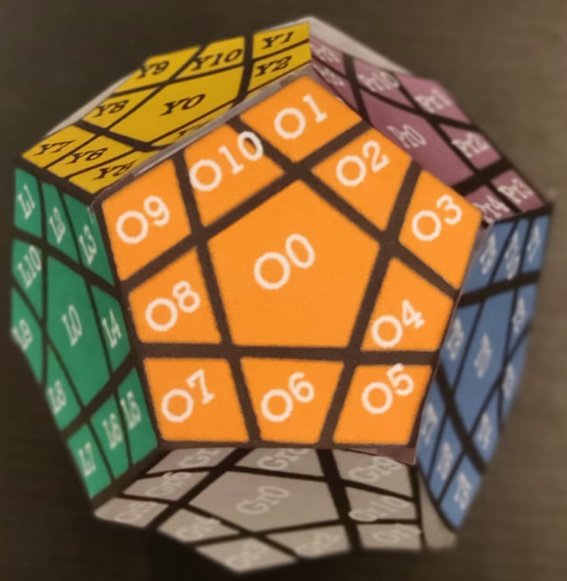
Numeration Method
u
br
bl
r
l
b
f
bdl
bdr
dl
dr
d

Slide 5
BACKUP

Slide 6
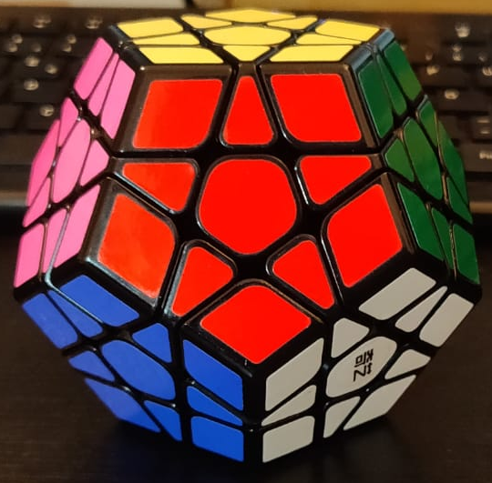
Beginning Position
U
L
R
Allowed Moves:
Up
Right
Front
Left
BACKUP
F

Slide 7
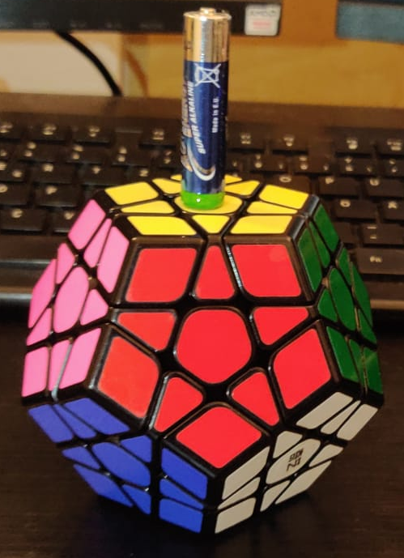
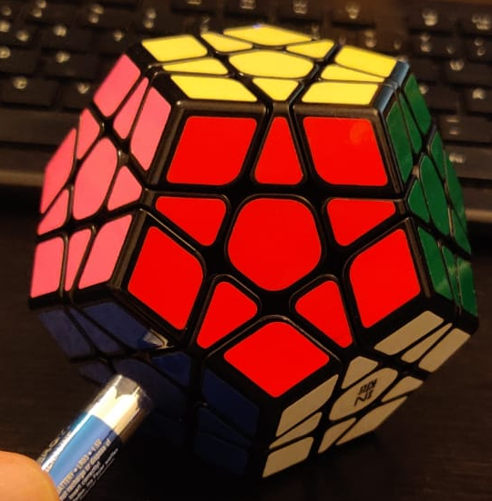
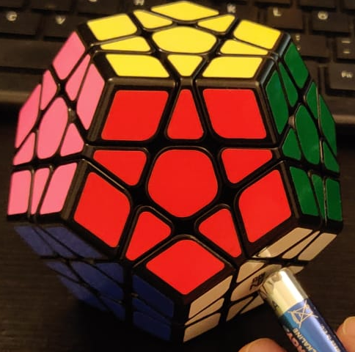
Axis Rotations
r_v
r_dr
r_dl
BACKUP

Slide 8
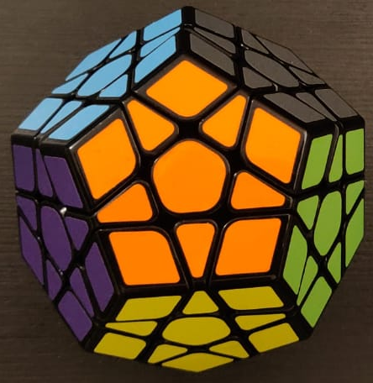
Numeration Method
u
br
bl
l
r
BACKUP
f
b
bdl
bdr
dl
dr
d

